Slide 1

The Hong-Kong controversies and impacts on foreign companies’ reputation.
Sofia Gruzdeva, Amélie Chloé Sciberras, Nelson Walz
Technische Universität München
Data Analytics for Cybercrime and Undesirable Online Behaviors
Professorship of Cyber Trust
25th of February 2020

Slide 2

Motivation
The Hong Kong crisis is an ongoing, deeply socially critical issue
China’s power and influence is expected to rise in the next years, also outside of their own country
The incident features digital, social, political aspects and such that potentially endanger global freedom of speech
Notes:
Because of the retrocession of the ex-English territory to China, the political climate is very tense since 1997. Despite the “one country, 2 systems” system that applies in the region, any move from the Hong Kong government that could restrict freedom provokes demonstrations. These last few months, the demonstrations and the repression of the authorities were very important, and the events evolution spread all around the globe.
More than 40 companies answered to the Hong Kong event (i e this is a trend in international companies, not a single event). Especially this situation is interesting for the tech companies, because they could be easily banned in China due to firewall.Maybe ask people what they think the challenges are for companies. Some public positions involve a major challenge for companies : there is a tradeoff “Loose the Chinese market vs harm reputation in democratic societies” : we would like to understand what is the consequence in terms of reputation for a company to choose the pro-chinese government side, and how we can explain this choice.
[don’t think we should say this here in the intro]To move the trade-off, we need to understand, did companies underestimate the reputation harm or is it really neglectable, i e the question is “How severe are companies’ reputations harmed?”

Slide 3
Agenda
Research Questions
Theoretical foundation
Overview of Study cases
Methodology
Results
Discussion
Limitations
Conclusion
Notes:
To answer to the research questions and present our findings, we will proceed as follows :
-Choice of two cases : first we will do a short refresher
-Then explain our methodology
-finally present the results
Put the research questions somewhere :
What causes companies to take steps towards their own censorship?
How do customers react to the steps taken by companies that give in to pressure?

Slide 4
Research questions
What causes companies to take steps towards their own censorship?
How do customers react to the steps taken by companies that give in to pressure?
Notes:
To answer to the research questions and present our findings, we will proceed as follows :
-Choice of two cases : first we will do a short refresher
-Then explain our methodology
-finally present the results
Put the research questions somewhere :
What causes companies to take steps towards their own censorship?
How do customers react to the steps taken by companies that give in to pressure?

Slide 5
Theoretical foundation - What causes companies to take steps towards their own censorship?
China's consumption is rising steadily, as is the digital market potential
Chinese market requires special behaviour of companies with which the state agrees
Economic censorship due to conflict of own, public and third power, in this case the chinese state (Richards und Murphy 1996)
Companies are not only committed to their own success, but also accountable for their actions through increased social valuation - New form of Corporate Social Responsibility (Theofilou et al. 2017; Bassen et al. 2005)
Reputation is essential for corporate success. Risk of shitstorms and financial losses.
Digital transformation of companies makes the actions of companies more visible, more short-lived and their reputation more vulnerable (Walsh et al. 2006; Taddeo und Floridi 2017; Grigore et al. 2017)
Companies face trade-off between reputation and requirements of the Chinese state to be able to operate in the market
Notes:
To answer to the research questions and present our findings, we will proceed as follows :
-Choice of two cases : first we will do a short refresher
-Then explain our methodology
-finally present the results
Put the research questions somewhere :
What causes companies to take steps towards their own censorship?
How do customers react to the steps taken by companies that give in to pressure?

Slide 6

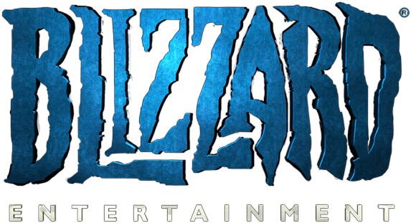

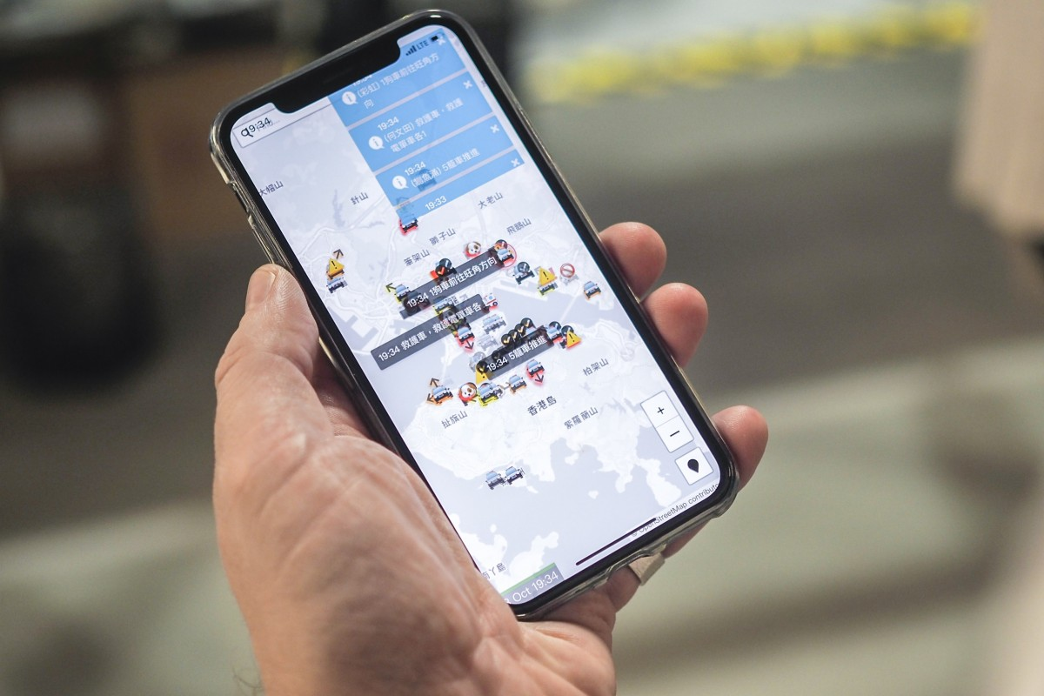
Study cases
The Blizzard case: Ban of Chung Ng Wai at Hearthstone Grandmasters
Chung “Blitzchung” NG Wai:
“Liberate Hong Kong, the
Revolution of our times”
The Apple case: Ban of multiple apps used by Hong Kong protestors in the App Store
Notes:
*Apple : ban of HKmap.live of the Appstore on 9th of October 2019, after facing a lot of criticism from the chinese state (chinese official said it was used to localise police officers and target/avoid them)
*Blizzard case : Chung Ng Wai, a Hong Kong-based player who goes by the name “Blitzchung,” expressed his pro-hong kong opinions after winning a match in the Hearthstone Grandmasters. He was banned from Blizzard for a year for this position on 7th of October 2019.

Slide 7
Methodology
Which data is used?
Apple’s and Blizzard’s case study
Reddit scrapping
Choice of time of the study
Does the event has a visible impact ?
Qualitative analysis
Number of submissions, comments, scores of the posts
What is an impact on people’s opinions ?
Microsoft Azure’s opinion analysis tool
Notes:
How we face question “How severe are companies’ reputations harmed?”
Study case analysis : 2 timely wide spread cases from news Apple and blizard
Why reddit : well organised in subthreads + easy to use with the request library from python. Also score metrics : helps to know the approval of a comment/ submission
Look at longest post, most commented post, post with highest score --> have an insight of the data.
Choice of 2 different views : close to the event (2 weeks before and 2 weeks after), and far from it (1st may to end of january) → that way we get long and short term involvement in the debate
Opinion analysis : Microsoft Azure and semantic analysis (retrieving words of interest) → real impact on companies’ reputation.
How we face question “How severe are companies’ reputations harmed?”
Two cases were chosen: Apple, Blizzard
Platform for collecting public opinions: Reddit
Methodology:
Overview of the event (here I mean N of submission before and after and and so on)
Semantic score
Qualitative analysis of comments

Slide 8
Results - The Blizzard case
Qualitative analysis
Event study
Opinion analysis

Slide 9
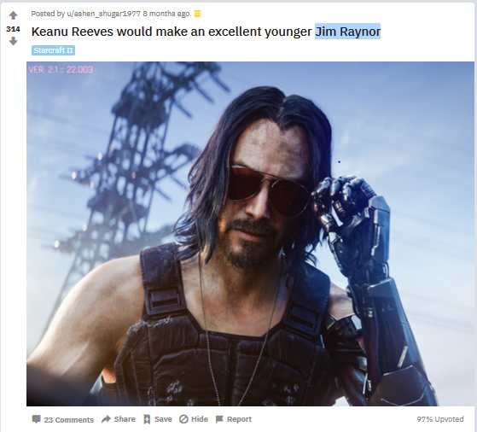
The Blizzard case - Qualitative analysis
Before the event : post with the best score
https://www.reddit.com/r/Blizzard/comments/bz0lm3/keanu_reeves_would_make_an_excellent_younger_jim/, last visited on 22nd of February 2020
Notes:
Before the event means : from 1st of May to 6th of October
Main idea of the slide : before the event, best scored post, most commented and longest ones are posts about the blizzard fan community
(here’s an example, Keanu reeves + famous actor, Jim Raynor = character of Startcraft game from Blizzard).

Slide 10
The Blizzard case - Qualitative analysis
After the event : extracts of longest post
Today, I am deeply disappointed and saddened by a developer who, for over two decades, has provided me with some of the most memorable and endearing gameplay experiences I’ve ever had. I am on the verge of deleting the Battle.net launcher and all Blizzard games, and never again considering any offerings they put forth [..]
Yesterday, you banned professional Hearthstone player blitzchung from Grand Masters for one year, and rescinded his first-place winnings in the tournament series over his decision to speak up in defense of the oppressed citizens of Hong Kong [...].
This action taken by you is unconscionable on every level. It is morally repugnant, and there is no redeeming angle from which to gaze upon this madness with a sympathetic view for you. Simply put, the only redeeming path you could commit to is a complete reversal of this decision, and to state in concrete terms that you refuse henceforth to put the desires of any oppressive regime ahead of that of freedom--not just freedom of expression, but all civil liberties [...].
https://www.reddit.com/r/Blizzard/comments/df6v8i/megathread_recent_blitzchung_situation_discussion/, last visited on 22nd of February 2020
Notes:
After the event means : from 9th of october to end of january
Deeply critical and disappointed player.
-post with best score : removed

Slide 11
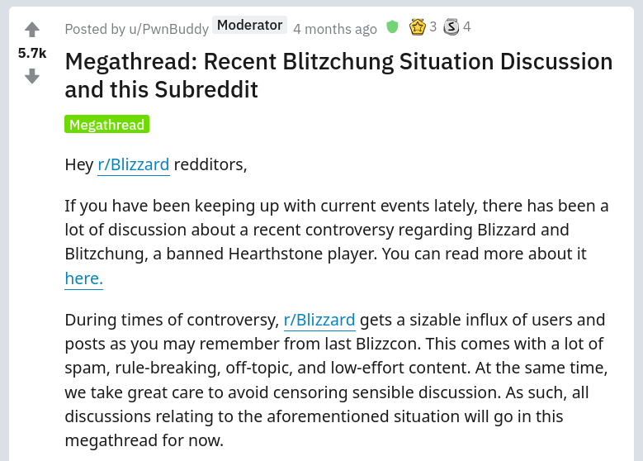
The Blizzard case - Qualitative analysis
After the event : most commented post
https://www.reddit.com/r/Blizzard/comments/df6v8i/megathread_recent_blitzchung_situation_discussion/, last visited on 22nd of February 2020
Notes:
After the event means : from 9th of october to end of january
-contain the buzz of the number of submissions from Reddit. Pro-hong kong comments.

Slide 12
Results - The Blizzard case
Qualitative analysis
Event study
Opinion analysis
Notes:
So qualitatively, we see a change of opinion, as many comments are pro-hong kong and against blizzard.
What about quantitatively

Slide 13
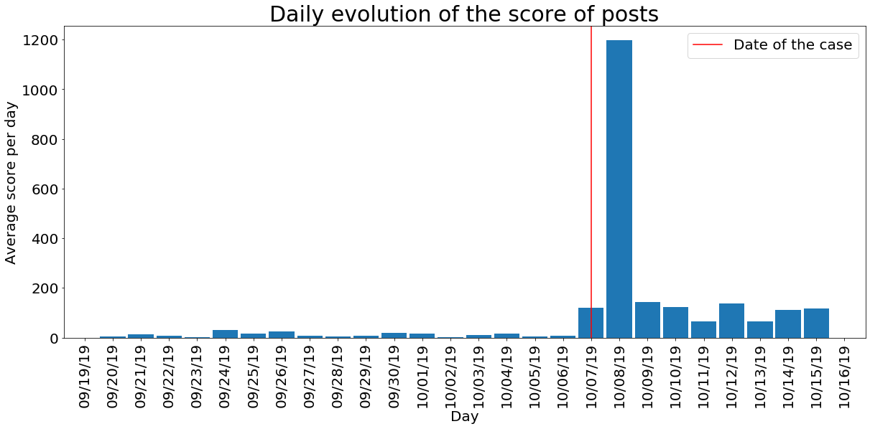
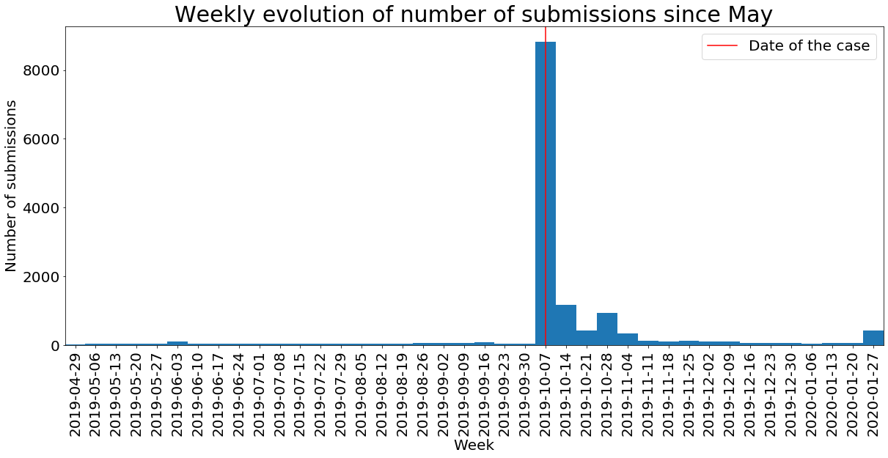
The Blizzard case - Event study
The redditors showed a great interest in the event
Notes:
After the event means : from 9th of october to end of january
Both graphs : involvement in the event : increase of score and number of submissions

Slide 14
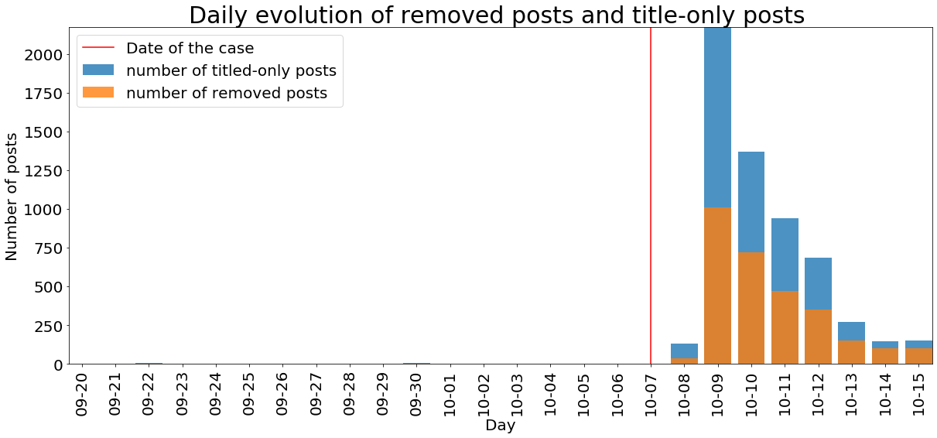
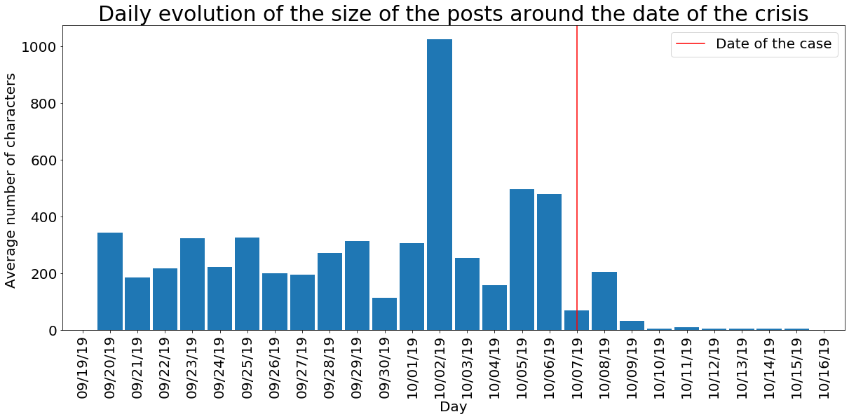
The Blizzard case - Event study
As a consequence of the moderation, the number of removed and short posts increased.
Notes:
After the event means : from 9th of october to end of january
-After the event : we have more submissions, and there are shorter. This can be because of the move of the moderators we explained earlier to contain the thread : people try to by pass the moderation with images as a critical image is way more hard to detect automatically than a critical text.

Slide 15
Results - The Blizzard case
Qualitative analysis
Event study
Opinion analysis

Slide 16
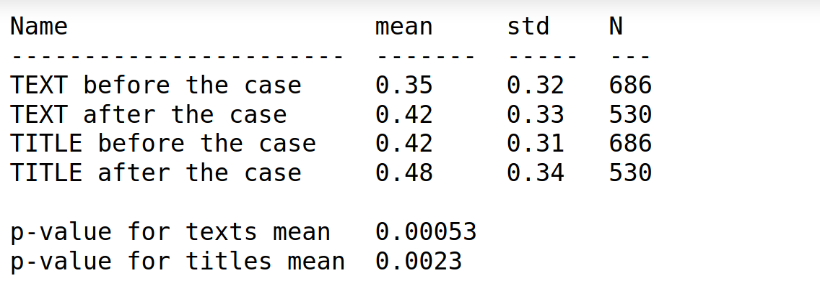
Opinion score increases after event
The Blizzard case - Opinion Analysis
Notes:
P-value < 5% so results statistically significant with a trust of 95%

Slide 17
Short insults and long discussions
Opinion Analysis
0.959492 score
”I'm sure a lot of you will be canceling your world of Warcraft subscriptions after this incident same as I will. so if any of you are looking for a new place to become a wild refugee there is a certain MMO made by S**are E**x that you might like. Just give F**al F****sy a try. You can play a free trial up to lvl 35 and see if you like it. At least they aren't banning people from their game for being against a certain totalitarian government.”
mean std
Before the case
Score for the 100 longest texts 0.27 0.38
Score for the 100 shortest texts 0.49 0.49
After the case
Score for the 100 longest texts 0.44 0.26
Score for the 100 shortest texts 0.39 0.36
0.977193 score
”I love starcraft 2, I love heroes of the storm, I had many fond memories of playing overwatch with my friends. But my love for them is not enough to convince me to let freedom die. I have family in Hong Kong, family that I no longer communicate with because we both know it would be dangerous if they were caught talking to an American. All I can do is hope someday I'll see them again, and that someday I'll get to see my heritage. I will never support tyranny. I will always support democracy, and I will always support freedom. It was a fun ride but I'm done with your shit.”
0.00192443 score
”This company sucks”
0.00112143 score
” Fuck you you stupid cucks ”
Notes:
The score goes up for the long re

Slide 18
Results - The Apple case
Qualitative analysis
Event study
Opinion analysis

Slide 19
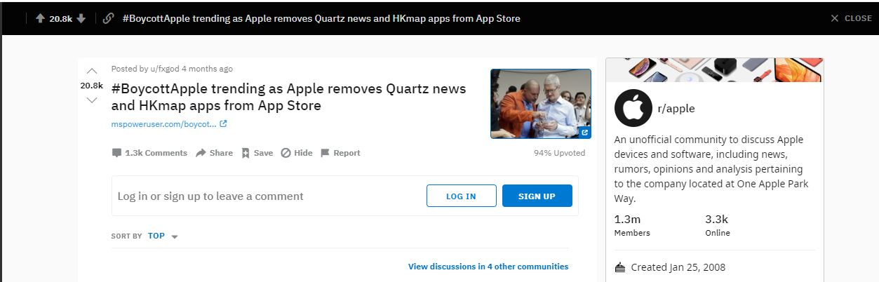
Apple - Qualitative Analysis
Top posts of /r/apple
Monthly perspective: Before & after crisis - no mentioning of HK in monthly top / most commented / longest posts (May to October 2019)
Content of popular posts: Product Reviews, WWDC, iPhone giveaway
Closer look reveals only one top post containing HK:
Highest Score of 9th of October - 23rd of October Post about this topic
https://www.reddit.com/r/apple/comments/dfxxpz/boycottapple_trending_as_apple_removes_quartz, last visited on the 23rd of February 2020
Notes:
Most commented: Air Pod Pro Release discussion, Longest: iOS 13 App Store Changes
Only this discussion got attention, in the 4 other communities the link did not get much attention

Slide 20
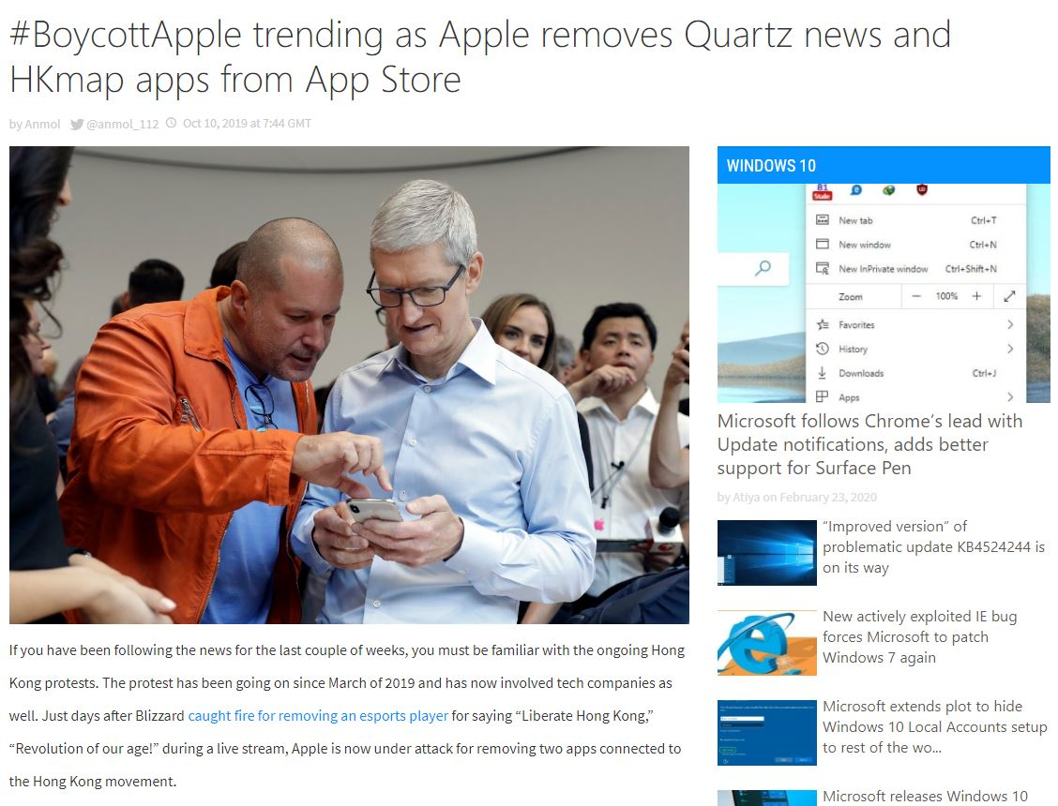
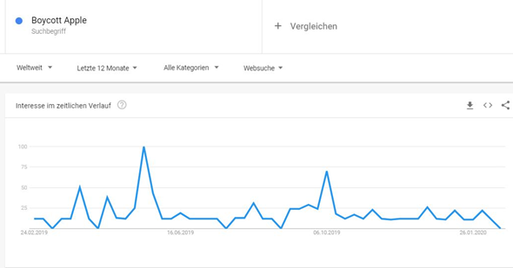
Only one high voted post on HK on /r/apple
Crosspost of tech blog “mspoweruser.com” reporting Apples App removal of Quartz News & HKMap.live
Blog, not credible news source, but: content is equal to reports of CNN, NY Times, The Guardian, BBC, Telegraph and many more credible sources
Blog reports peak of #boycottapple
https://trends.google.com/trends/explore?q=Boycott%20Apple, last visited on the 23rd of February 2020
https://mspoweruser.com/boycottapple-trending-as-apple-removes-quartz-news-and-hkmap-apps-from-app-store/, last visited on the 23rd of February 2020

Slide 21
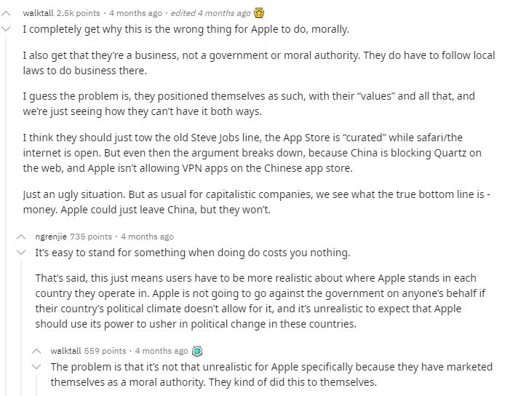
Most voted comment on this reddit post
Addressing ethical and economic aspects
Moral perspective of Apple is questioned
Critique of Capitalism
https://www.reddit.com/r/apple/comments/dfxxpz/boycottapple_trending_as_apple_removes_quartz, last visited on the 23rd of February 2020

Slide 22
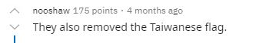
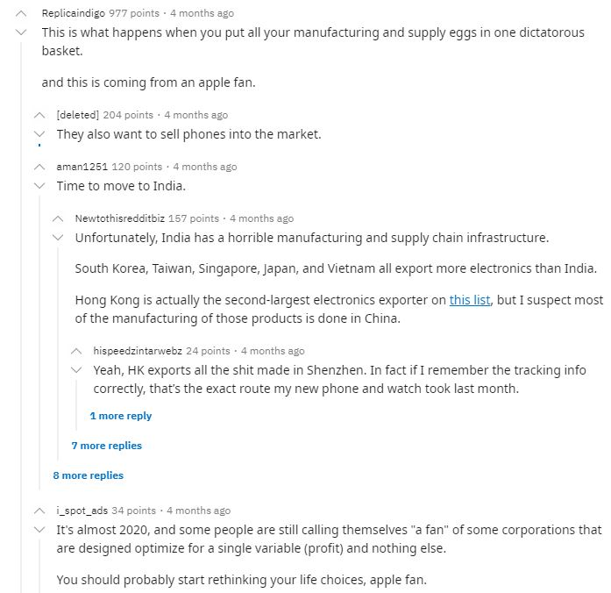
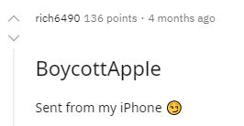
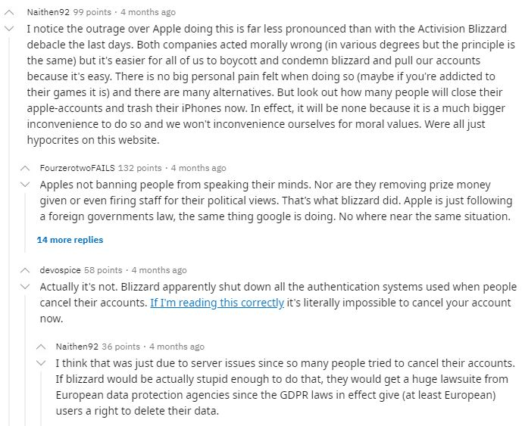
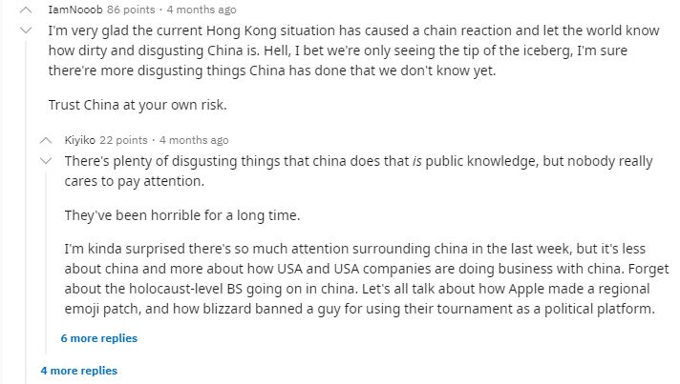
Other top voted comments
3rd highest voted comment
Referencing the Blizzard Case
Further criticism of Apple and businesses
Root cause analysis by users
4th highest voted comment
2nd highest voted comment
5th highest voted comment
6th highest voted comment
All from: https://www.reddit.com/r/apple/comments/dfxxpz/boycottapple_trending_as_apple_removes_quartz, last visited on the 23rd of February 2020

Slide 23
Summary of top comments qualitative analysis
Generally strongly negative comments and evaluations, occasionally neutral comments, no positive ones
Despite Apple's brand loyalty no defense among the comments with the most encouragement
Search for causes, solutions and connections with general HK problems
Critique of China and capitalism
Signs of anger and disappointment beyond the specific case

Slide 24
Results - The Apple case
Qualitative analysis
Event study
Opinion analysis
Notes:
So qualitatively, we see a change of opinion, as many comments are pro-hong kong and against blizzard.
What about quantitatively

Slide 25
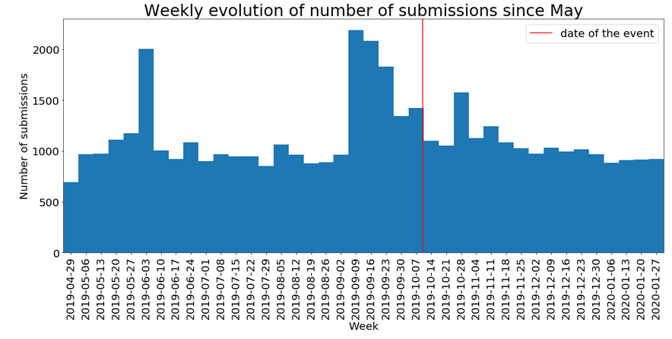
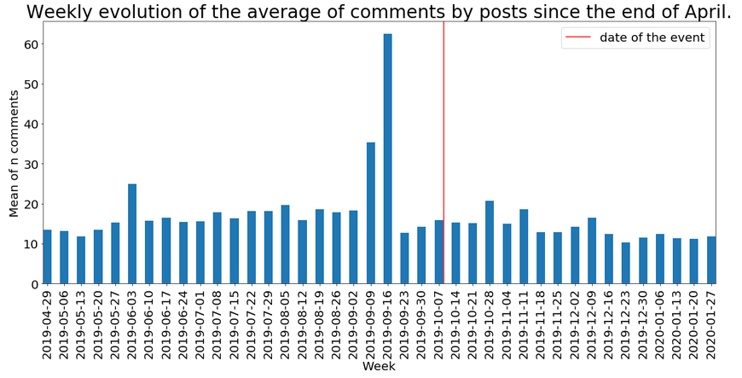
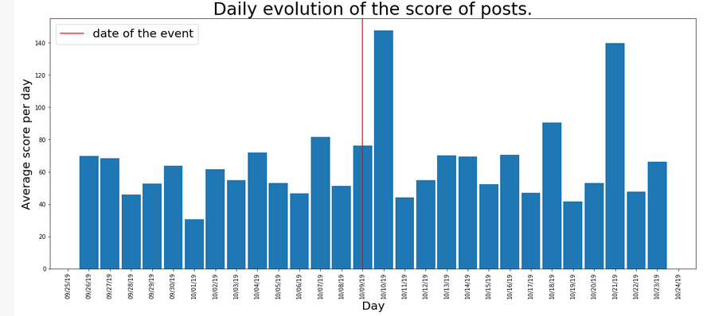
The Apple case - Event study
The redditors show poor interest in the case.
Notes:
After the event means : from 9th of october to end of january
-Nothing could have made us guess the date of the event given these graphs :
Transition : no involvement from the people in the case ? Let’s look at the evolution of the score.

Slide 26
Results - The Apple case
Qualitative analysis
Event study
Opinion analysis

Slide 27
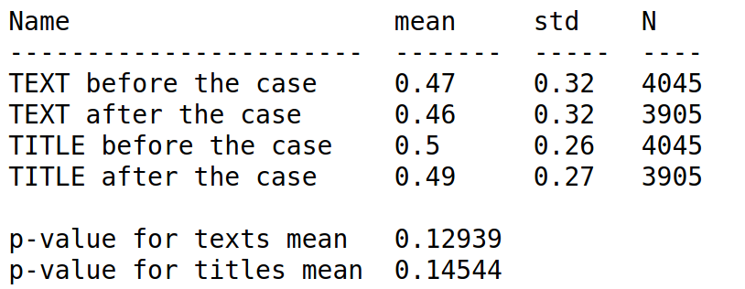
Opinion score did not change
The Apple Case - Opinion Analysis
Notes:
P-value < 15% so results statistically significant with a trust of 85%

Slide 28
Discussion
Why are results different for these cases?
Notes:
(here we can first ask the audience, so we will have some kind of interaction with public and people will not get too bored during our presentation)

Slide 29
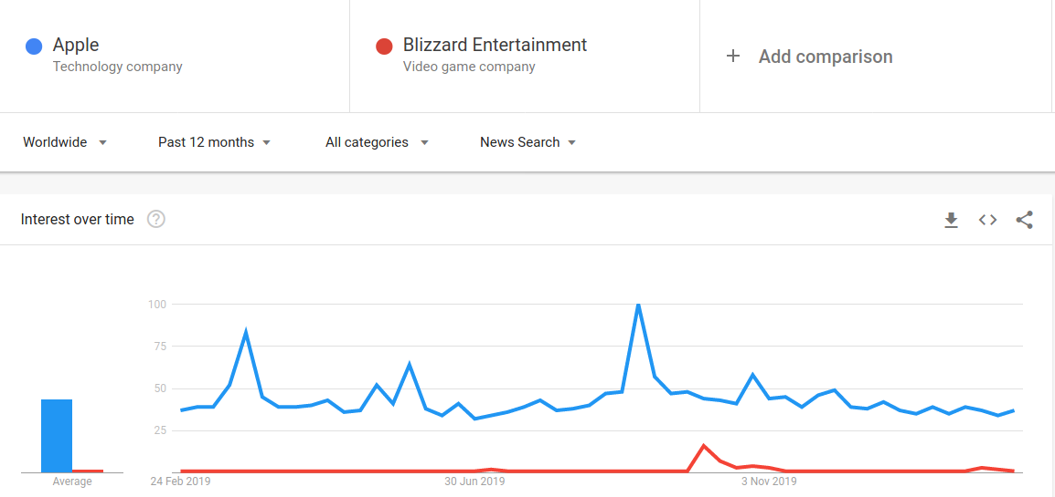
Discussion - Buzz comparison
Apple is more in the spotlight
https://trends.google.com/trends/explore?q=%2Fm%2F0k8z,%2Fm%2F01jx9, last visited on 24th of February 2020
Notes:
Release dates for apple

Slide 30
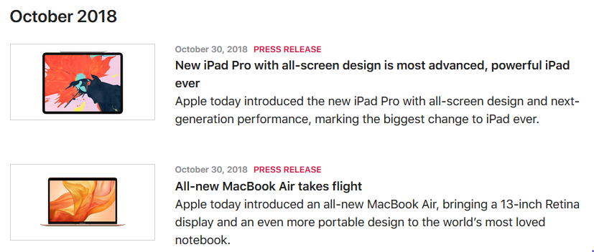
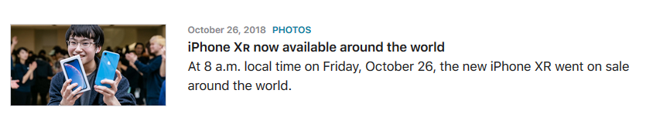
Discussion - Buzz comparison
Apple’s buzzy October
https://www.apple.com/newsroom/archive/?page=2, last visited on 24th of February 2020
Notes:
Release dates for apple Iphone mid-september and all products in october

Slide 31
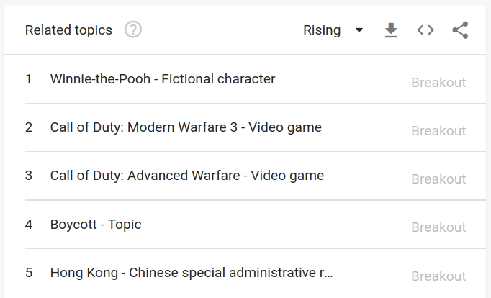
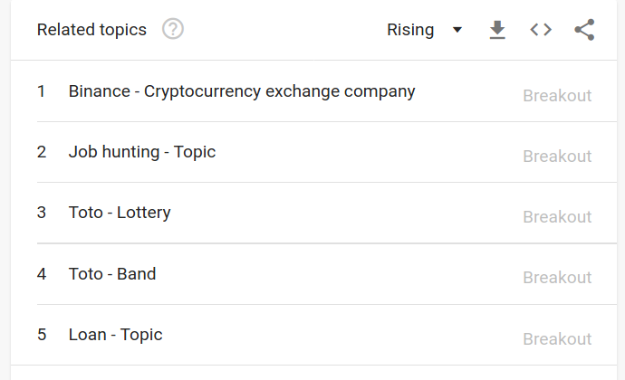
Discussion - Audience comparison
Blizzard audience is more specific
Blizzard : Related googled topics are often games
Apple : Related googled topics are more diverse
https://trends.google.com/trends/explore?q=%2Fm%2F0k8z,%2Fm%2F01jx9, last visited on 24th of February 2020

Slide 32
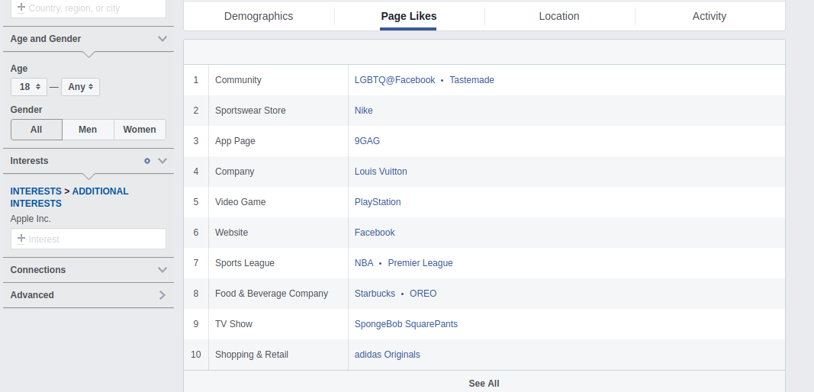
Discussion - Audience comparison
Facebook analytics: Apple’s community has diverse interests
https://www.facebook.com/ads/audience-insights/, last visited on 24th of February 2020

Slide 33
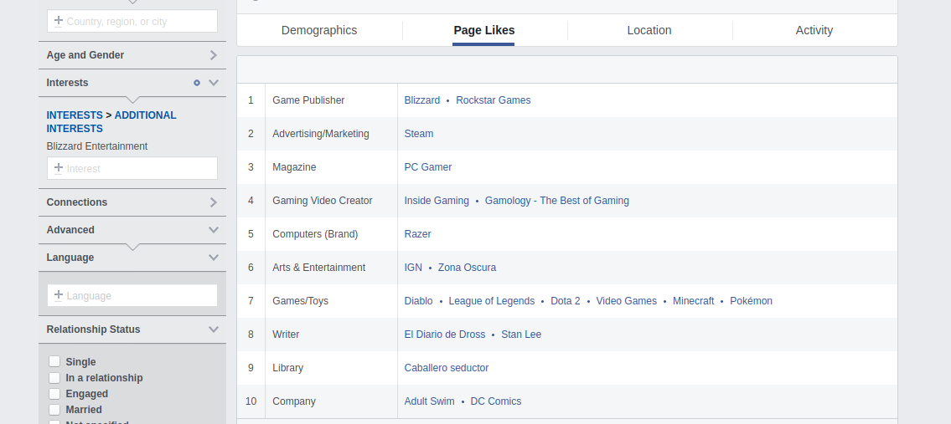
Discussion - Audience comparison
Facebook analytics: Blizzard’s community has more entertaining interests
https://www.facebook.com/ads/audience-insights/, last visited on 24th of February 2020

Slide 34
Discussion
“Why are results different for these cases?”
Apple is more in the spotlight
Different audiences from the two brands
The first case is more individual and a clear attempt to freedom of speech
The second case involves public security
Notes:
More news about Apple - > more other topics to discuss. - Apple in general more in the focus of media
Different audiences = different interests
The Blizzard case is targeting 3 persons, firing 2 of them for expressing political opinions. This is a clear attempt to their freedom of expression, and this is targeting individuals. The Apple case is about removing an app because its use could, officially, harming the physical security of individual Hong Kong policemen. It is less personal, and the app did not expressed political opinion in the first place. Then it is unclear whether it is an attempt to freedom of political belief or not, compared to the Blizzard case.

Slide 35
Limitations
Case study - methodological limitations
Technical limitations of Microsoft Azure tool
Reddit limitation through user characteristics
Removed posts can occur
Pictures & posts not in English can not be analysed
Reputation as a soft factor, not directly measurable
Multiple steps not visible:
Chinese government motivation / politics
Intern company management perspective
Notes:
Case study limits : as we said in the methodology we wanted to study these events

Slide 36
Conclusion
The public reaction depends on
The case
The company previous reputation and event frequency.
The type of audience
Blizzard - reputation has been harmed
Apple - the reaction is negligible
Companies reputation is fragile in the digital age.
Measurement of public reaction is not sufficient to prevent companies censorship
Notes:
Different results for each company/ case
Company motives and constraints not visible from outside
For Blizzard, we have shown that the company’s reputation was harmed by their pro-chinese reaction
For Apple, we found out that the reaction was not enough to harm their reputation as it many other events occurred at the same time and focus most of the interest of people.

Slide 37
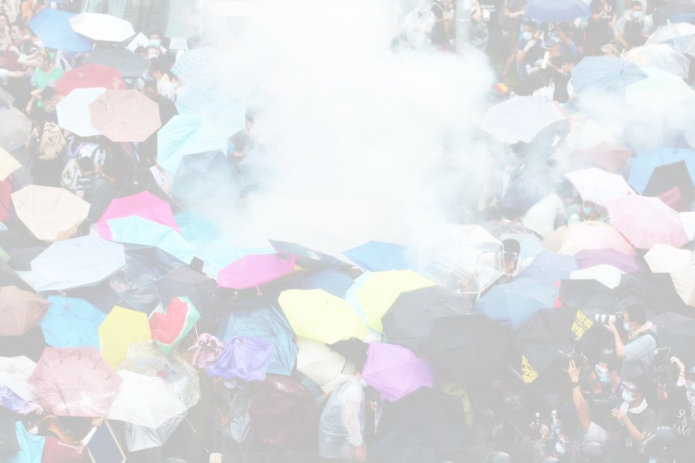
Final questions ?

Slide 38
References - Links
https://www.apple.com/newsroom/archive/?page=2, last visited on 24th of February 2020
https://www.facebook.com/ads/audience-insights/, last visited on 24th of February 2020
https://imgur.com/gallery/153qt3a, last visited on the 23rd of February 2020
https://mspoweruser.com/boycottapple-trending-as-apple-removes-quartz-news-and-hkmap-apps-from-app-store/, last visited on the 23rd of February 2020
https://www.reddit.com/r/apple/comments/dfxxpz/boycottapple_trending_as_apple_removes_quartz, last visited on the 23rd of February 2020
https://www.reddit.com/r/Blizzard/comments/df6v8i/megathread_recent_blitzchung_situation_discussion/, last visited on 22nd of February 2020
https://www.reddit.com/r/Blizzard/comments/df6v8i/megathread_recent_blitzchung_situation_discussion/, last visited on 22nd of February 2020
https://www.reddit.com/r/worldnews/comments/dfuqwp/free_hong_kong_chants_get_fans_kicked_out_of_nba/f361ofo/, last visited on the 23rd of February 2020
https://trends.google.com/trends/explore? q=Boycott%20Apple, last visited on the 23rd of February 2020
https://trends.google.com/trends/explore?q=%2Fm%2F0k8z,%2Fm%2F01jx9, last visited on 24th of February 2020

Slide 39
References - Literature
Bassen, Alexander; Jastram, Sarah; Meyer, Katrin (2005): Corporate Social Responsibility. Eine Begriffserläuterung. In: zfwu 6 (2), S. 231–236. DOI: 10.5771/1439-880X-2005-2-231.
Grigore, Georgiana; Molesworth, Mike; Watkins, Rebecca (2017): New Corporate Responsibilities in the Digital Economy. In: Anastasios Theofilou, Georgiana Grigore und Alin Stancu (Hg.): Corporate Social Responsibility in the Post-Financial Crisis Era, Bd. 43. Cham: Springer International Publishing, S. 41–62.
Richards, Jef I.; Murphy, John H. (1996): Economic Censorship and Free Speech: The Circle of Communication between Advertisers, Media, and Consumers. In: Journal of Current Issues & Research in Advertising 18 (1), S. 21–34. DOI: 10.1080/10641734.1996.10505037.
Taddeo, Mariarosaria; Floridi, Luciano (Hg.) (2017): The Responsibilities of Online Service Providers. Cham: Springer International Publishing (Law, Governance and Technology Series).
Theofilou, Anastasios; Grigore, Georgiana; Stancu, Alin (Hg.) (2017): Corporate Social Responsibility in the Post-Financial Crisis Era. Cham: Springer International Publishing.
Walsh, Gianfranco; Dinnie, Keith; Wiedmann, Klaus‐Peter (2006): How do corporate reputation and customer satisfaction impact customer defection? A study of private energy customers in Germany. In: Journal of Services Marketing 20 (6), S. 412–420. DOI: 10.1108/08876040610691301.

